Slide 1

A World Without Agile
Imagine . . .
Otto Berkes | CTO, CA Technologies
Notes:
Welcome/background /PC Revolution
Today, at a crossroads

Slide 2
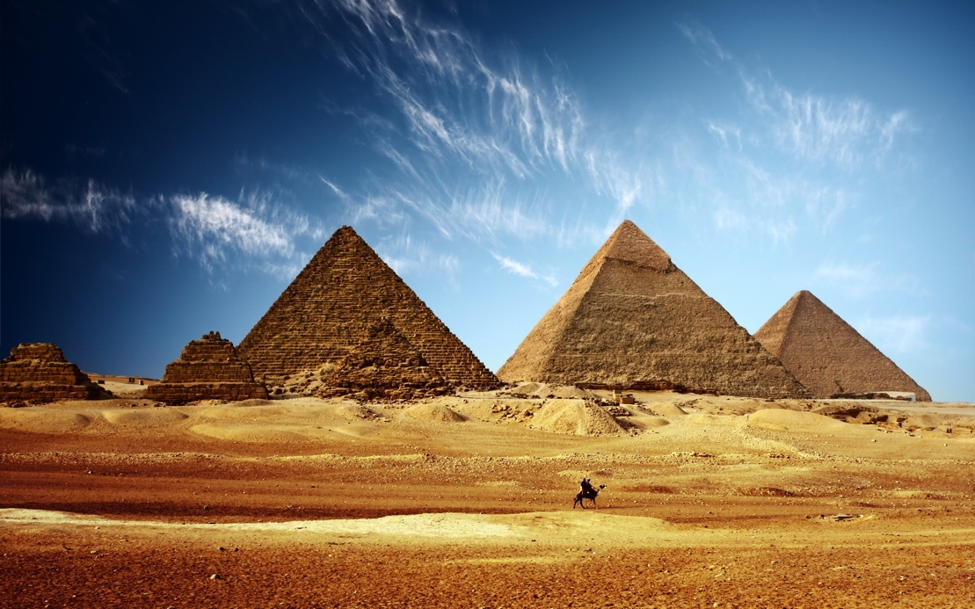
Waterfall has been around as long as humans have been building things
Notes:
Back in time / straightforward
No ONE way to do anything

Slide 3
Notes:
Back in time / straightforward
No ONE way to do anything

Slide 4
But software is different from physical objects…
…and (next slide) driven by exponential change
But software is different from physical objects …

Slide 5

Notes:
Moore’s Law, storage, data, traffic.
Rate of change/uncertainty

Slide 6

Even WITH Agile We Are At A Crossroads
Notes:
Acceleration/proliferation of technologies
protocols, frameworks, standards, and APIs = choices

Slide 7
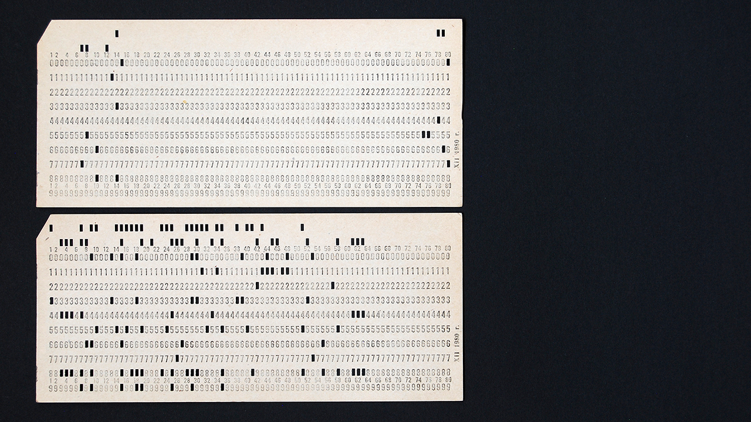
Notes:
Back in time / straightforward
No ONE way to do anything

Slide 8
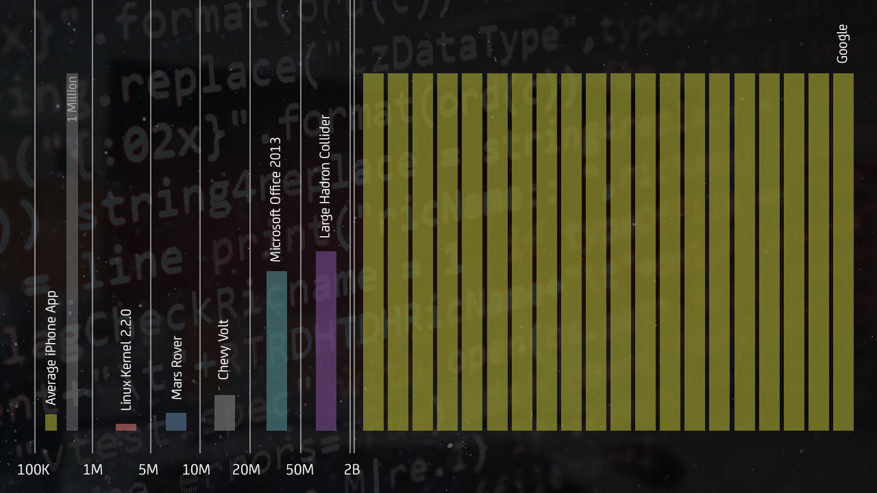
Notes:
Legacy is considerable / lines of code / project that out / not pretty
Google’s systems….2B lines of code.

Slide 9
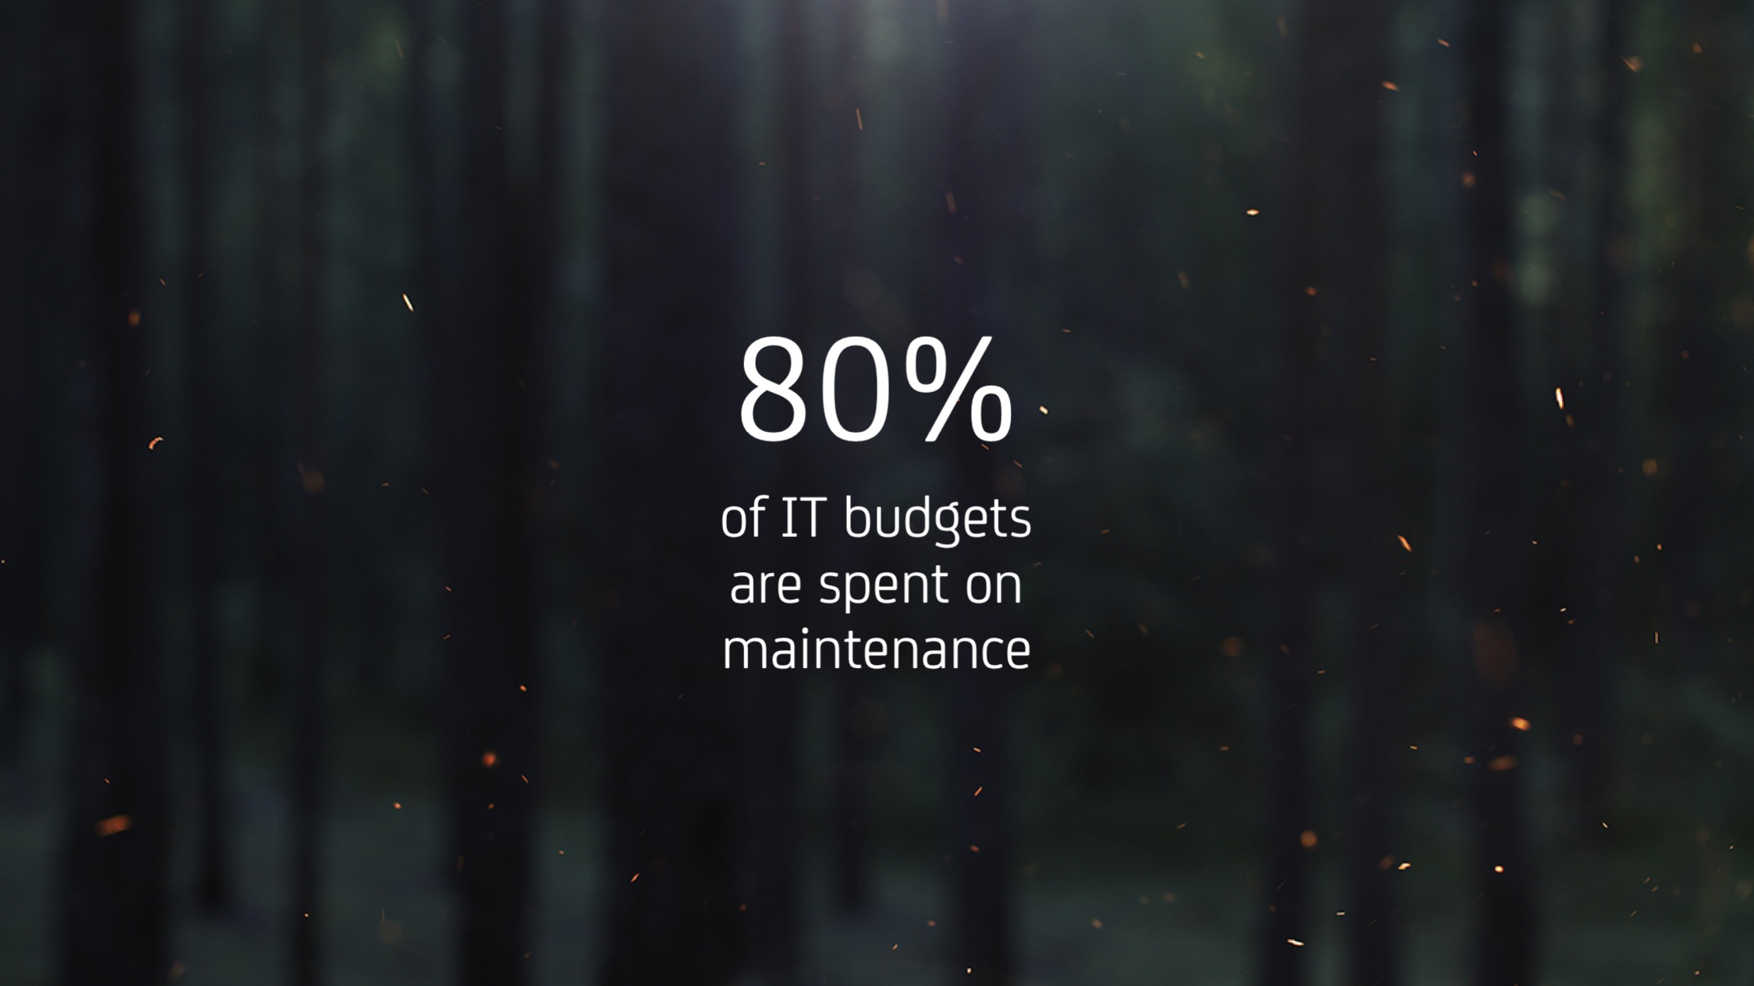
Notes:
Cost / dead money / No innovation = no success
No good time to refactor / Backlog grows

Slide 10
Notes:
Maintaining legacy / no way out / no map / not moving forward

Slide 11
CA Has “Gotten” Agile …
Market Share Position¹⁵
Gartner
Forrester
IDC Marketscape
#1
Service Virtualization
Gartner names CA a Leader in:
API Management¹
Project and Portfolio Management²
Application Release Automation³
IT Portfolio Analysis Applications⁴
Identity Governance and Administration⁵
Enterprise Agile Planning Tools⁶
Forrester names CA a Leader in:
API Management⁷
Application Performance Management⁸
IDC MarketScape names CA a Leader in:
Project and Portfolio Management⁹
#1
Agile Lifecycle Management
#2
API Management
#2
IT Project & Portfolio Management
KuppingerCole
#2
Privileged Access Management
Ovum
KuppingerCole names CA a leader in:
Privileged Access Management¹²
Single Sign-On¹³
Adaptive Authentication¹⁴
#2
Release Automation
Ovum names CA a Leader in:
API Management¹⁰
Privileged Identity Management¹¹
#2
Network Performance Monitoring
#2
Mainframe
1Magic Quadrant for Full Life Cycle API Management,” Paolo Maliverno and Mark O’Neill, October 27, 2016
2Magic Quadrant for IT Project and Portfolio Management Software Applications, Worldwide,” Daniel B Stang, Robert A Handler, Teresa Jones, May 24, 2016
3Magic Quadrant for Application Release Automation, Colin Fletcher, David Williams, Laurie Wurtser, August 1, 2016
4Magic Quadrant for Integrated IT Portfolio Analysis Applications, 2015,” Daniel B. Stang and Stefan Van Der Zijden , November 22, 2016
5Magic Quadrant for Identity Governance and Administration,” Felix Gaehtgens, Brian Iverson, Perry Carpenter, Kevin Kampman, February 22, 2017
6Magic Quadrant for Enterprise Agile Planning Tools, “Thomas E Murphy, Mike West, Keith James Mann, April 27, 2017
Gartner does not endorse any vendor, product or service depicted in its research publications, and does not advise technology users to select only those vendors with the highest ratings or other designation. Gartner research publications consist of the opinions of Gartner's research organization and should not be construed as statements of fact. Gartner disclaims all warranties, expressed or implied, with respect to this research, including any warranties of merchantability or fitness for a particular purpose.
11

Slide 12
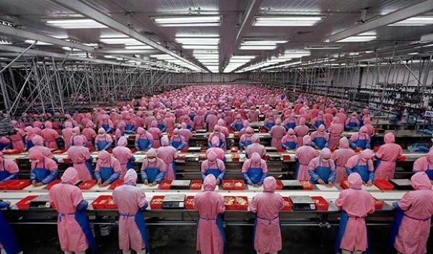
Many companies using agile development practices
but a waterfall approach to new product development

Slide 13
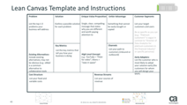
CA Accelerator: a lean/agile approach to incubation
Model ensures business incubations are making appropriate investments and building things customers need
Funding
Startup
Continued experimentation and customer involvement ensures there is a paying market before large scale development investments are made
Scale
Incubation
Rapid pivots at small scale (1-4 people) ensures fast, cost-efficient confirmation of a customer validated problem and potential solution prior to building a product
Exit Accelerator
Leverage CPO expertise to scale
Product-Market
Fit
Lean Canvas
Problem-Solution
Fit
Time
Seed 1:
Exit with Customer-Problem Fit
Seed 2:
Exit with Problem-Solution Fit
Series A:
Exit with MVP built, Early Adopter
Series B:
Exit with Solution-Product Fit
Series C:
Exit with Product-Market fit

Slide 14
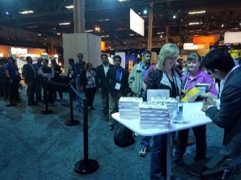
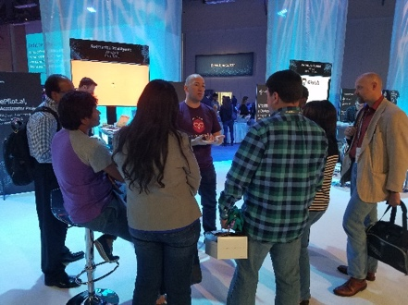
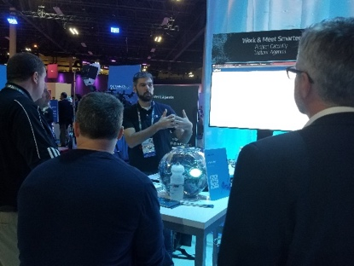
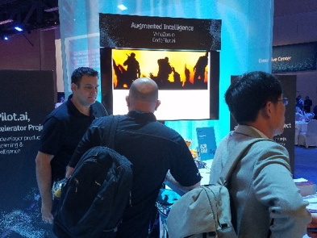
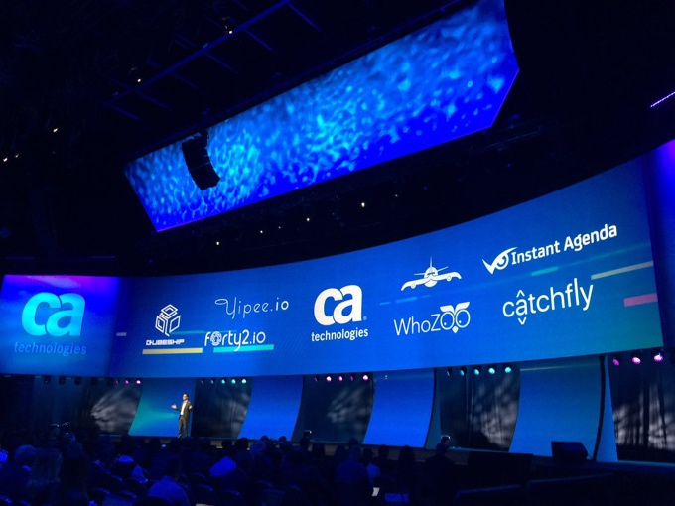
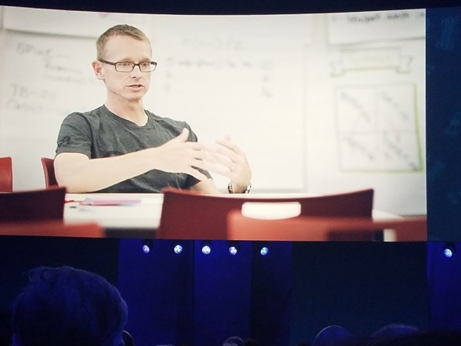
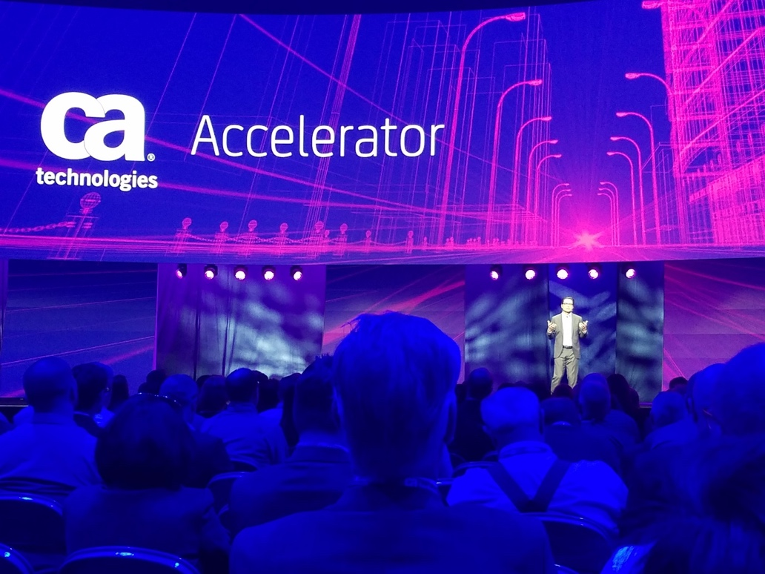
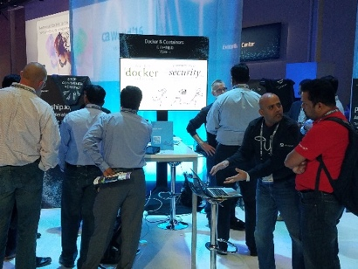
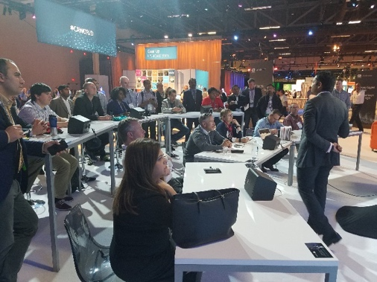
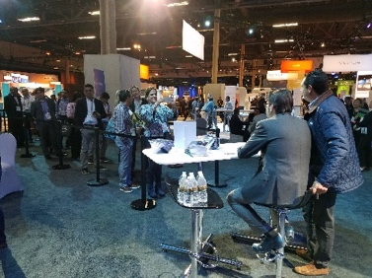
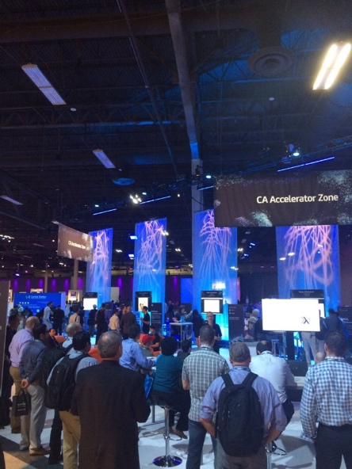
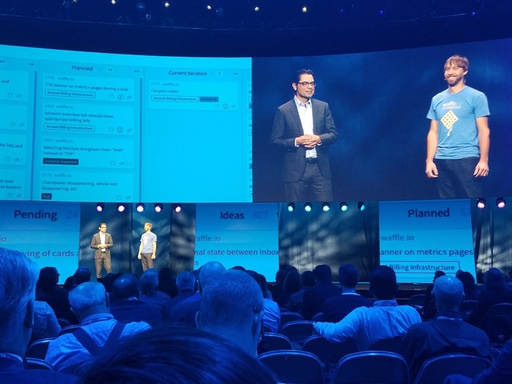
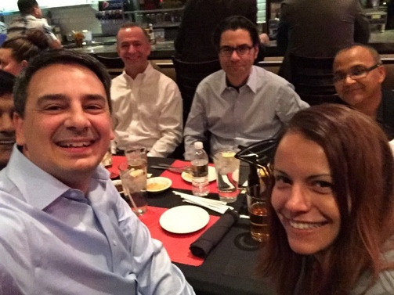
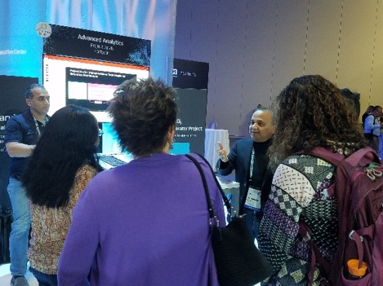
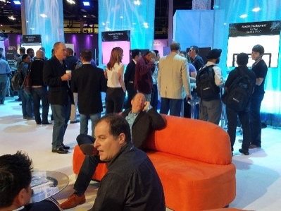


Slide 15







JARVIS
Cabot
WhoZoo
(exited to CPO)
CodePilot.ai
KnowThings.io
Notes:
Let me just talk through some of the incubations we are working on and the enterprise focus areas they address.
Containers, Microservices:
Yipee.io: Modeling tool for container-based devops
Qubeship.io: Continuous delivery of container-based apps via proven workflows
FreshTracks.io: Next-gen, container-centric monitoring
DevOps:
Cabot: Chatbot for DevOps site reliability engineers
CodePilot.ai: Developer co-pilot powered by deep learning
Waffle: Smart and simple project management for GitHub
IoT
KnowThings.io: Virtualization for IoT devices, gateways, and protocols
Organizational Productivity
Instant Agenda: Run leaner, more productive meetings
WhoZoo: Find and connect with the right people in your organization
Big Data Analytics, AI, ML
Project Jarvis: Advanced analytics engine embedded in key CA products

Slide 16







The
Modern
Software
Factory
The capabilities you need,
from mobile to mainframe,
to deliver the experiences
customers want.
Agile
DevOps
Security
AGILE TOOLS, PROCESSES & CULTURE
DevSecOPS with END-TO-END SECURITY
AUTOMATION
FEEDBACK LOOPS TO DRIVE EXPERIENCE
Notes:
Building a modern software factory is now table stakes for staying competitive. There are many roads to making this a reality, different paths you can choose depending on your starting point, your competitive landscape, existing technology footprint, and your objectives, resources, and priorities.
No matter what your journey looks like, we have solutions that are designed to help you produce the outcomes that matter most to you.

Slide 17

IDEA FACTORY
SOFTWARE FACTORY
Notes:
Below is modern software factory (book)
Design, develop, test, deploy / automated / constant flow of releases
Devops/agile prople process

Slide 18
But software is different from physical objects…
…and (next slide) driven by exponential change
Software is disposable/ recycleable?

Slide 19

CREATIVE DESTRUCTION
Notes:
constant CREATIVE DESTRUCTION in all aspects of the technology lifecycle.
Complicated by silos / culture
Agile helping

Slide 20

Agile + Big Data + AI = ?

Slide 21

Notes:
Enabling human ingenuity and creativity.
What’s the POINT of technology?? Have we forgotten?
Up-level “about people and what we’re capabe of creating”
Photographer Christopher Lettermayer
http://cklettermayer.com/gallery/football-fans/

Slide 22

Notes:
Use technology intelligently to create intelligent technology …
Up to all of us in room to see the forest or the trees.

Slide 23

Otto Berkes
Chief Technology Officer
Otto.Berkes@ca.com

