Slide 1
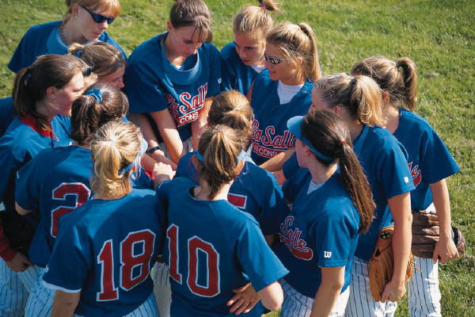
12+ Months of Agile
Story about the transformation from June 2012 till today
Kari Penttilä| VP Engineering | 17th Sept. 2013

Slide 2
Goals of agile transformation

Slide 3
Goals
As set forth by engineering director Martin Jansa
We should always have functional product
Shorter lead times
Decreased project risk
Constant sustainable phase (the work load of the teams)
Higher efficiency of the team
High flexibility for the scope changes

Slide 4
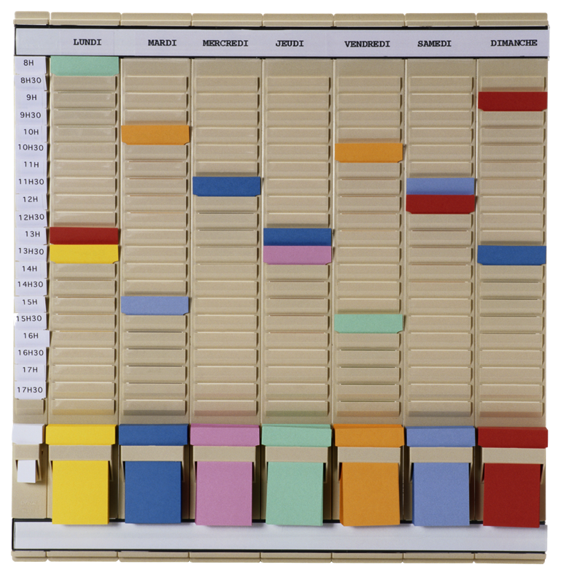
What did we do?

Slide 5
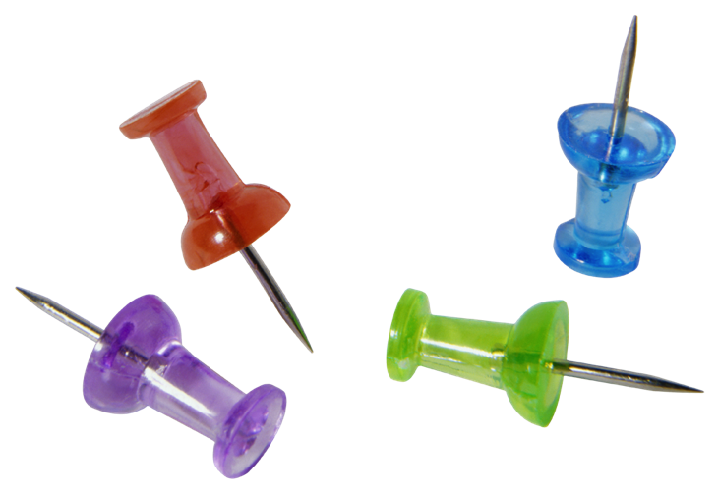
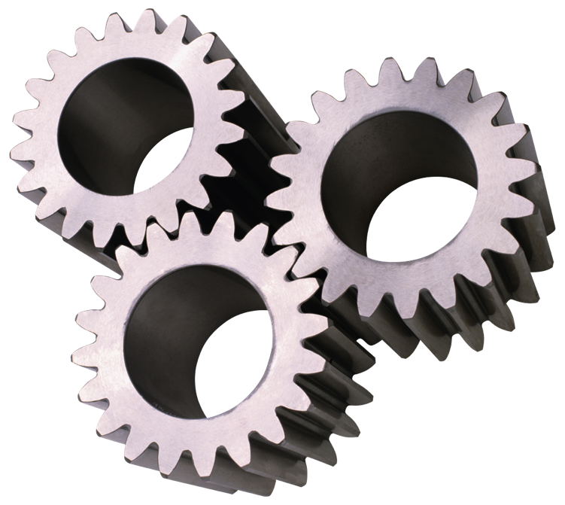
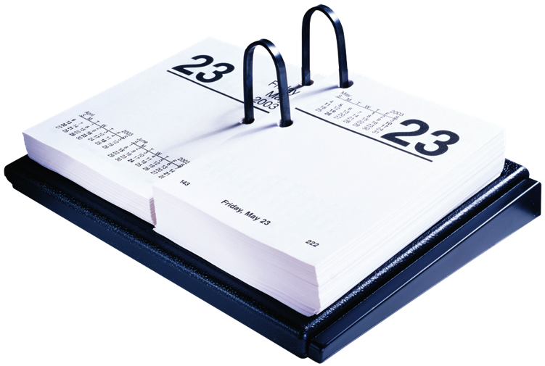
STARTING POINT

Slide 6
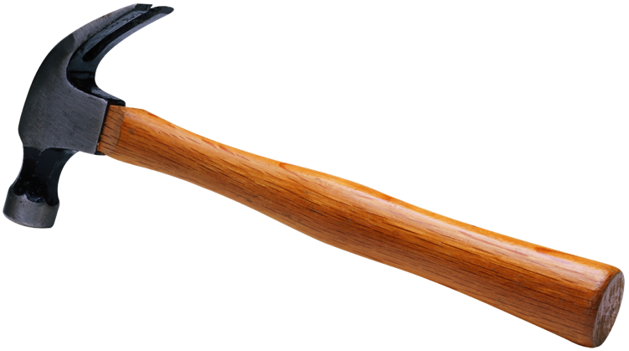
METHODOLOGY
SCRUM / KANBAN

Slide 7
TEAM STRUCTURE
COMPONENT OR FEATURE?

Slide 8
STRUCTURAL CHANGES
ARCHITECTURE
PROJECT MNGMT.
PRODUCT MNGMT.

Slide 9
THEN SOMETHING VERY UNEXPECTED HAPPENED!!!!!!!!!!!!!

Slide 10
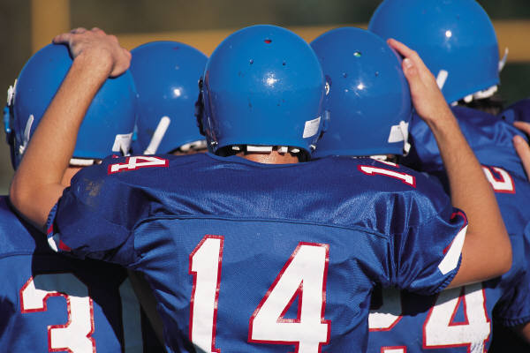
INTEGRATION OF QA,
ROLE OF TEST ENGINEER

Slide 11
FEEDBACK AND DEMOS

Slide 12
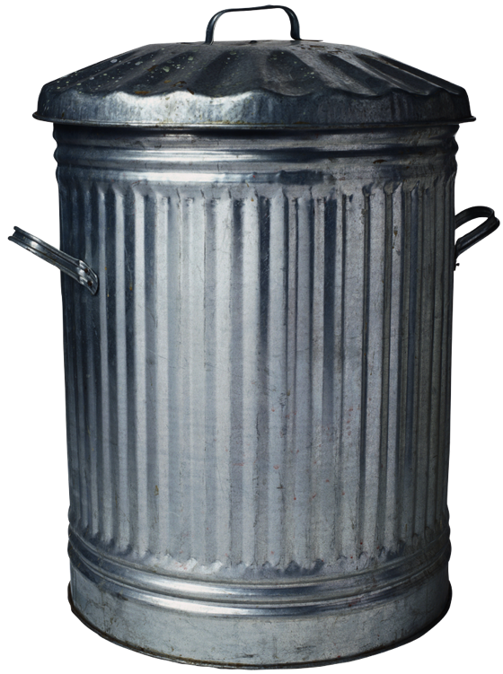
UNDERSTANDING
WASTE IN ENGINEERING

Slide 13
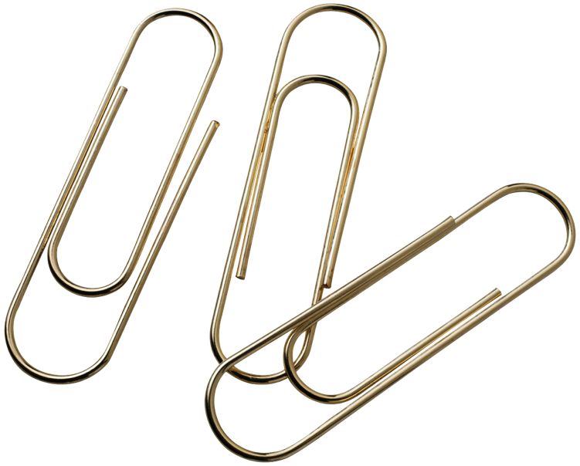
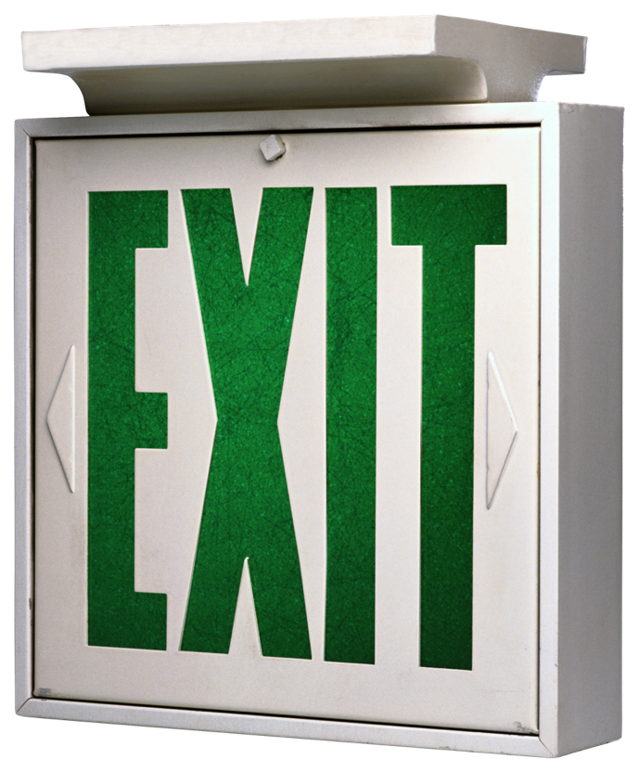
TOOLS / SYSTEMS

Slide 14
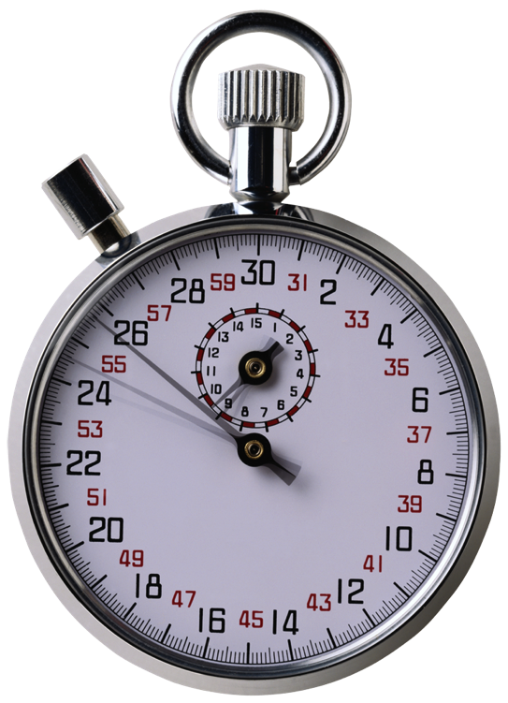
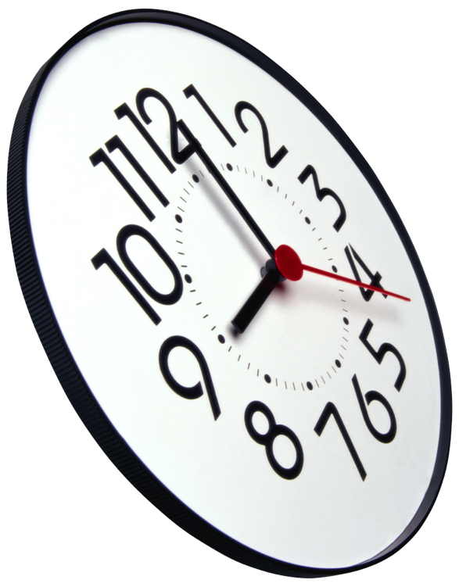
CONTINUOUS
INTEGRATION

Slide 15
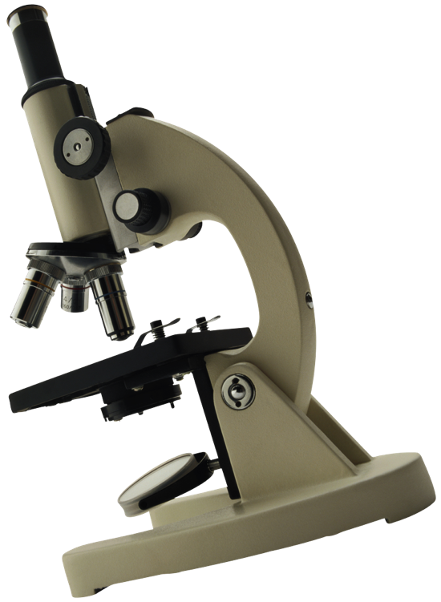
CONTINUOUS
IMPROVEMENT
RETROSPECTIVES

Slide 16
CAPACITY BASED PLANNING
SIMPLIFIED PLANNING
UTILIZATION
PLANNING HORIZON
RELEASE

Slide 17
Did we succeed?

Slide 18
BUT WE ARE NOT PERFECT – JORNEY GOES ON…
YES!
SEPT. 4, we released
PC TuneUp 2014
AVG Antivirus 2014
No overtime was needed to deliver the products

Slide 19
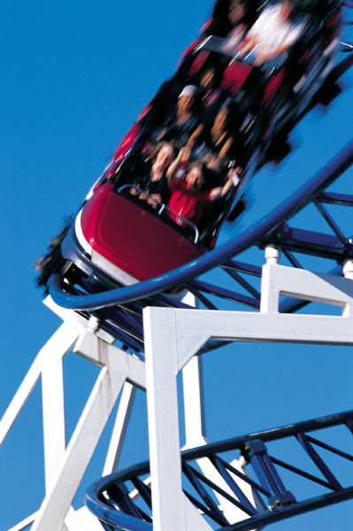
If you are going to do this in your company…

Slide 20
Agile transformation is work in progress.
Not conformance of plan to become agile
DEFINE THE GOALS AND START THE JORNEY TOWARDS THEM

Slide 21
Questions
?
Kari Penttilä | VP Engineering | T 724 027 462 E kari.penttila@avg.com

Slide 22
About Me
Agile and lean SW engineering enthusiastic
Over 25 years of experience in ICT industry of that 15 years in management.
Strong start-up experience, but been working in corporations too.
Have run 17 different R&D organizations.
Done couple of agile transformations before.
Now based in Brno working for AVG Technologies since 2.1.2013.
kari.penttila@avg.com

