Slide 2
How to build a customer portal from scratch

Slide 3
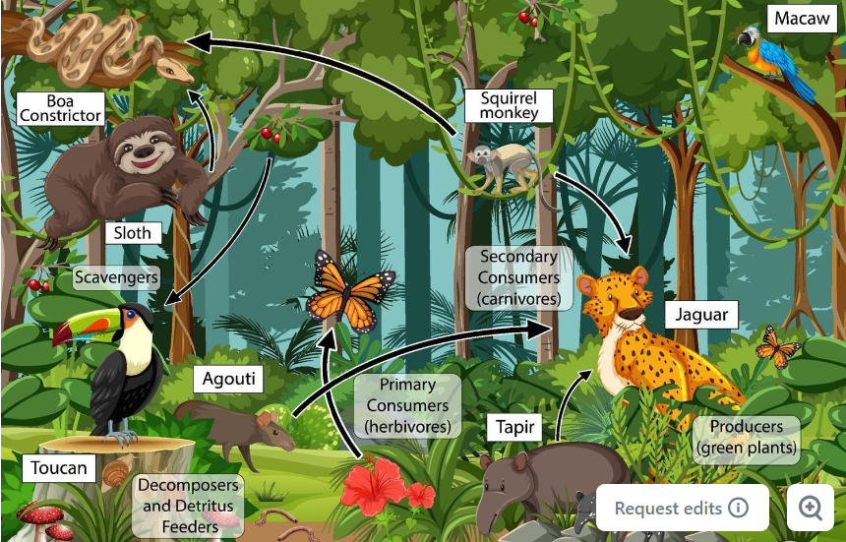
BUSINESS CONTEXT

Slide 4
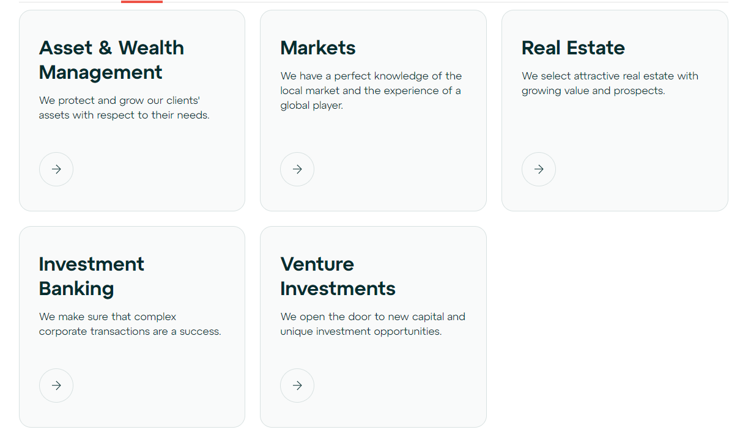

Slide 5
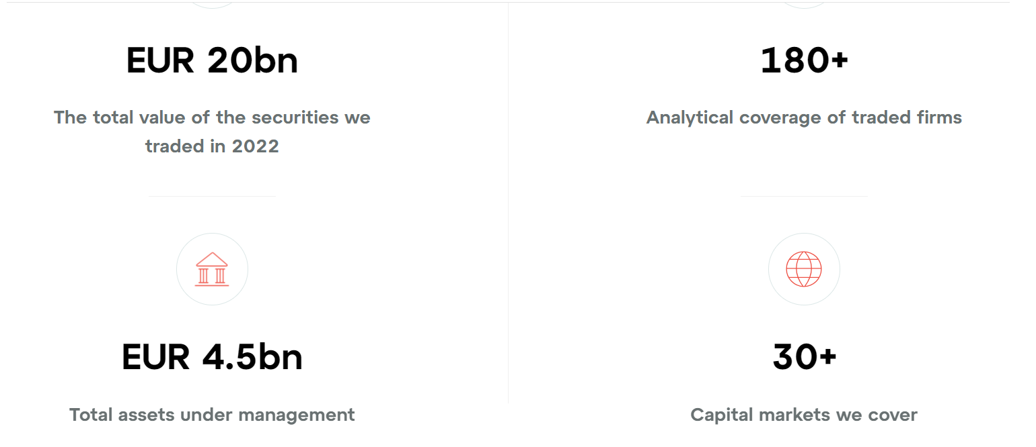

Slide 7
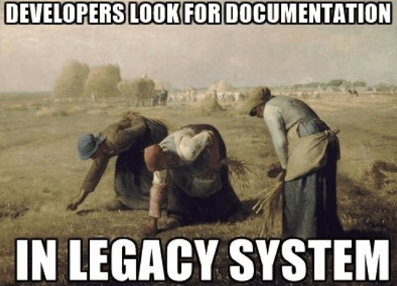
THE PROBLEM

Slide 8
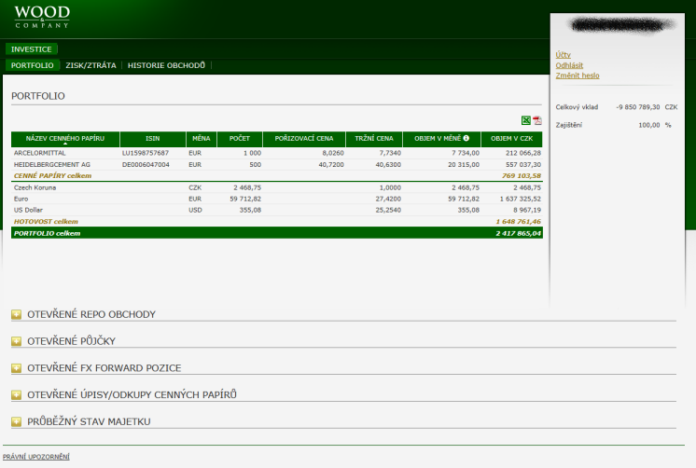
LEGACY CUSTOMER PORTAL
FEW ISSUES…

Slide 9
TEAM

Slide 10
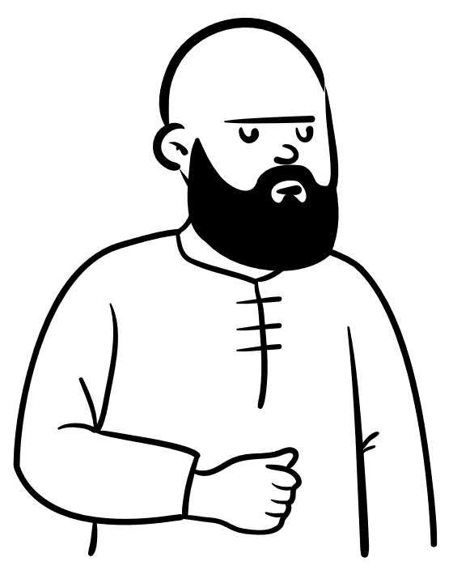
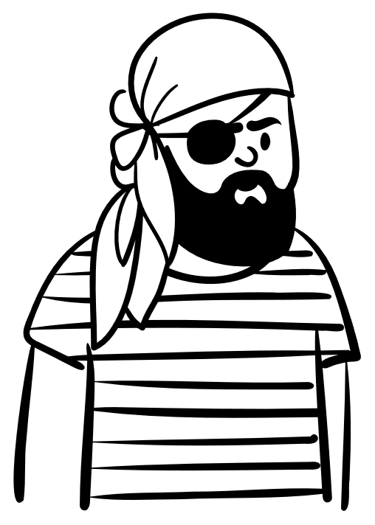
.NET BE DEVs
Product owner
CRM DEVs
FE DEVs
JAVA DEVs
Data warehouse DEVs
3
1
3
2
4
2

Slide 11
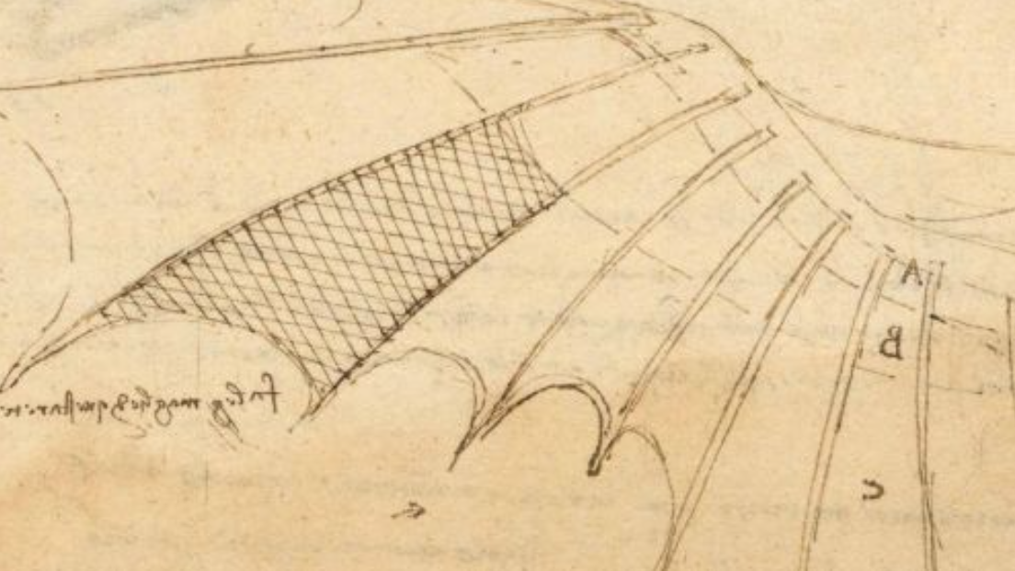
TECH STACK

Slide 12
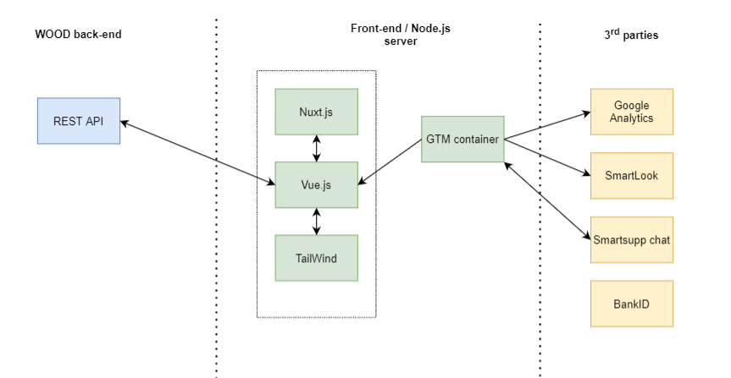
Tech stack - FE

Slide 13
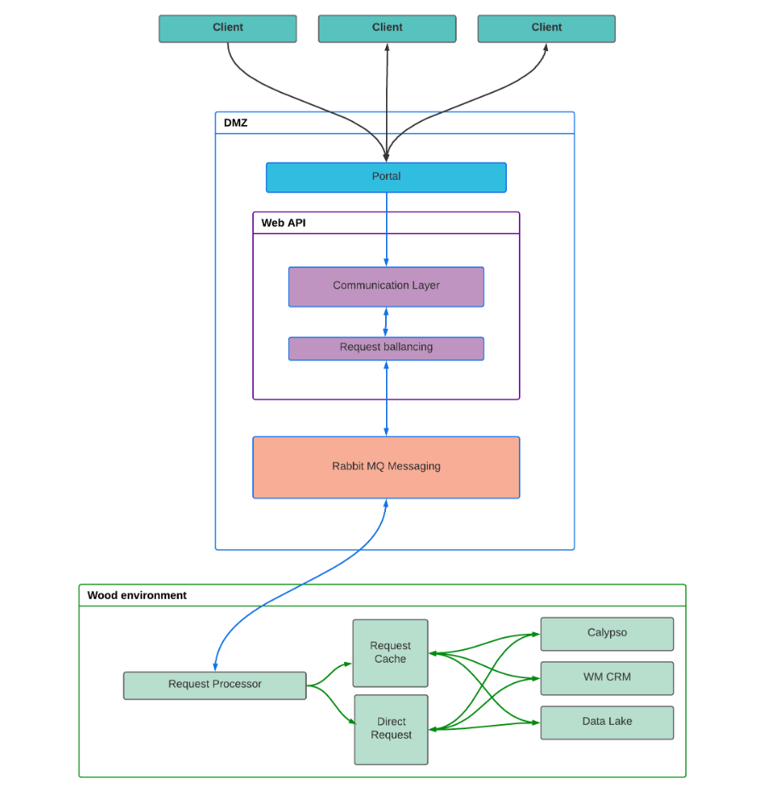
Tech stack - BE

Slide 14
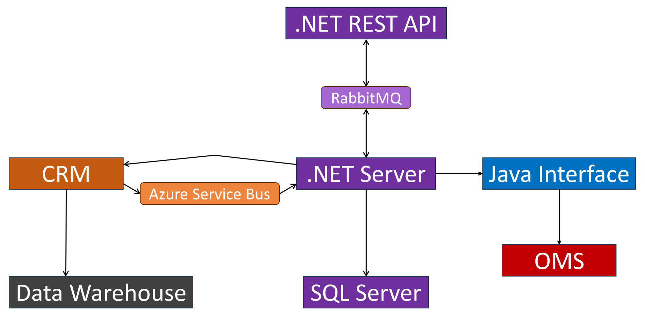

Slide 15
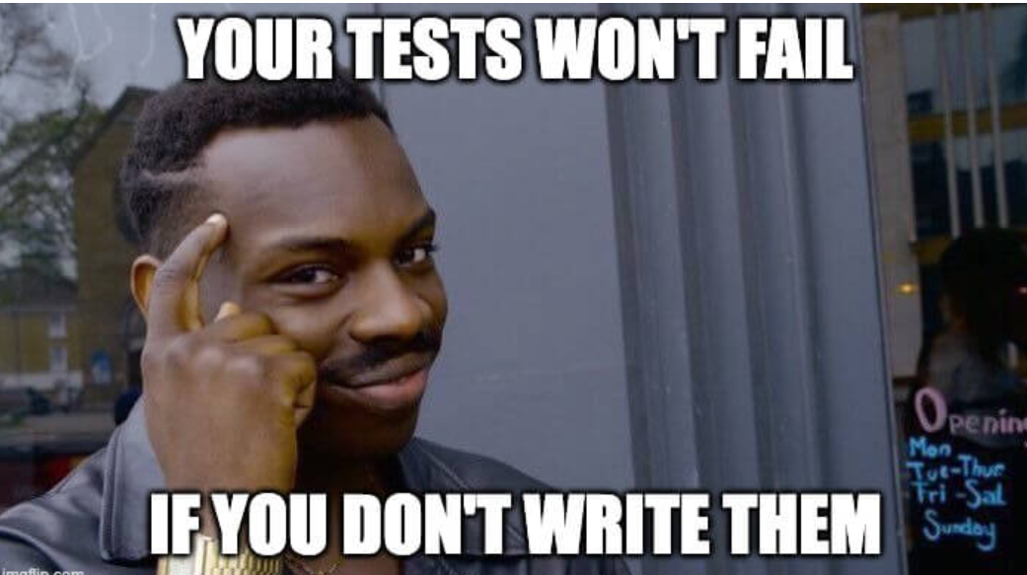

Slide 16
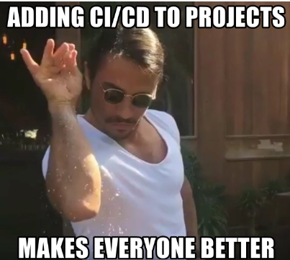

Slide 17
LEGACY CLIENT EXPERIENCE

Slide 18
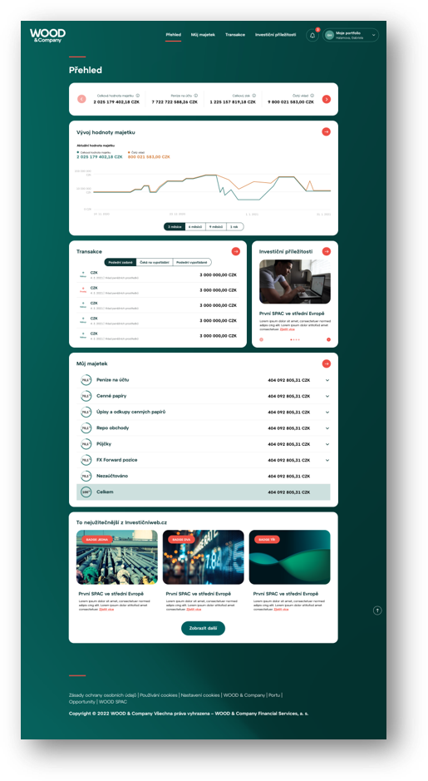
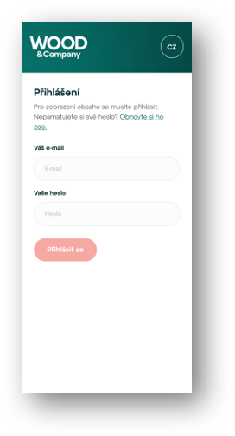
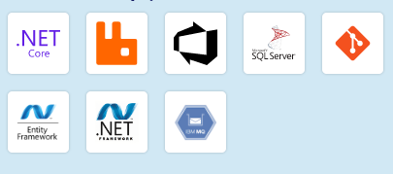
NEW CLIENT EXPERIENCE
FE: Vue.js, Nuxt.js
BE: .NET REST API, RabbitMQ,
Azure service bus
>1MIO orders / day

Slide 20
Thank you!

