Slide 1
3 Secret Techniques Great Agile Coaches use for Successful Coaching Angelina Dimova

Slide 2
TIMEBOXING:
presentation
demonstrations
Q&A

Slide 3
What Neuro Linguistic Programming means
It looks at the ways our brains interpret the signals they receive and how these interpretations affect what we do – behaviour & language.

Slide 4
A well-trained coach has complete awareness of:
The words they used
What questions they asked
Changes in voice tone
Changes in body posture and physiology
What they listened out for when talking to someone
How they structured their language

Slide 5
Intro to the thought-provoking process We process information better in silent environment

Slide 6
Notes:
Emotions will display on your face and body too, they also will drive the output- the behavior. Happy – smile and dance , Sad -
The NLP Communication Model explains how we take information from the outside world into our neurology and how that, in turn, affects our thoughts, feelings and behaviours. ⁠ ⁠ Whatever is happening inside your MIND will reflect into the model of the world you see.⁠ This ongoing process results in thoughts coming together to create internal representations (or maps of reality). ⁠ In NLP, we believe that "The map is not the territory," so the internal representations that we make about an external event are not actually the event itself.⁠ ⁠ ⁠What happens is that there is an external event, and we run that event through our internal processing.⁠ We make an Internal Representation of that event. The Internal Representation of the event then combines with physiology to create a state. The word "STATE" refers to the internal emotional state of the individual "happy, sad, motivated" etc.⁠ Did you ever notice that people treat their perceptions differently? Some people have to "see" certain relationships between things, where others have to have it explained or so they can "hear it". Still, others have to "get a grasp or a feeling" for the relationships. ⁠ It is the essence of the NLP Communication Model.⁠
Deletion: Deletion occurs when we selectively pay attention to certain aspects of our experience and not others. We overlook or omit others. Without deletion, we would be faced with too much information. Maybe you already are overloaded with information and you feel like you have too much.
Distortion: Distortion occurs when we misrepresent reality by making shifts in our experience of sensory data. In Indian philosophy, there is a well-known story of distortion in the rope versus snake analogy. A man walking along the road sees what he believes to be a snake and yells “SNAKE.” However, upon arriving at that place he is relieved as he discovers that what he sees only a piece of rope.
Distortion is an important component to the NLP Communication Model and can be used to motivate ourselves. Motivation can happen when we actually misrepresent, change or garble the material that has come into our neurology. The information has been changed by one of our filtering systems.
Generalization: Finally, comes generalization, and here we draw global conclusions based on one or two experiences. Do you know someone who has one experience and forms an opinion about all similar experiences? EG: “I hate all Indian music because I have heard Ravi Shankar and did not like it.”
⁠

Slide 8
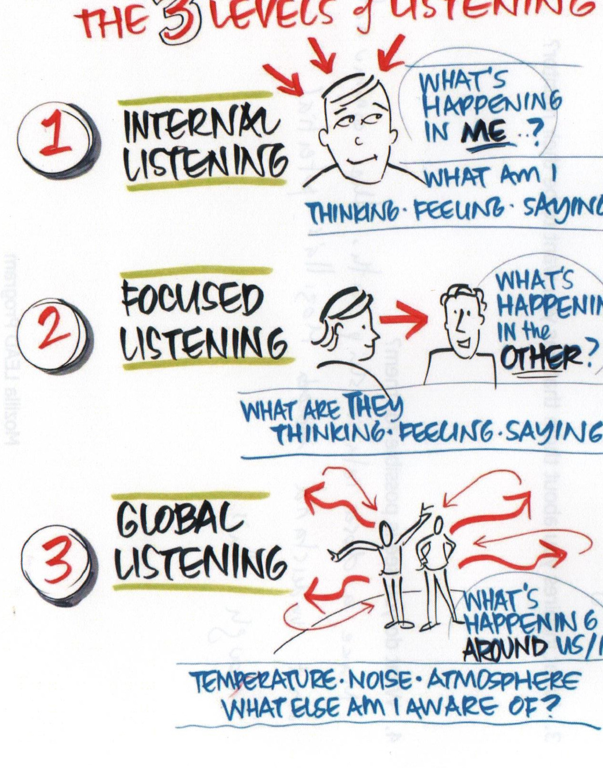
Environment impact on the thought-provoking process Think about the environment and how it affects the coachee’s behavior

Slide 9
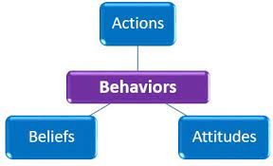
Technique 1 Listen for patterns Uncover failure patterns to turn into successful strategies

Slide 10
Fix the person not the problem
Focus the coachee on his patterns that lead to failure to change for success

Slide 11
Programs or patterns are developed from young age.
We execute them every day.
Some are leading to success, other are leading to failure.
Coaching should focus the coachee on identifying both. That is what we call extracting strategies.
Most often extracted strategies are about decision making, achieving peace of mind or recovering confidence.
(Q: How do you decide?) That is so called nominalization word or words that hide a process. That’s where you focus a powerful question that will start the thought-provoking process. Sit in silence and listen.

Slide 12
Questions
How do you do (something)
When was the last time you did (something) successfully?
What steps did you take to achieve (that)?
If you repeat that in the future situation, will you achieve success?
What can you do differently?
Is there a step you want to add?

Slide 13
Demonstration Eye accessing pattern

Slide 14
Technique 2 The power of silence How to know when to remain silent during the coaching conversation

Slide 15
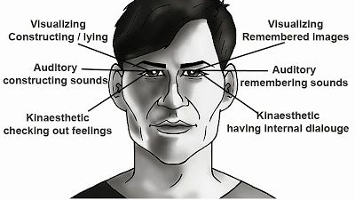
Eye Accessing Pattern
rapid eyes movement – impulsive decision
centre straight imaging deep focus
up centre - searching for information
Eyes will show you when the thought-provoking process is active.
Do not interrupt it.

Slide 16
In essence

Slide 17
Demonstration Patterns/Extract a strategy

Slide 18
Technique 3 Consciously influencing people
Parrot vs Para phrasing
Associations & Assumptions

Slide 19
Influencing Why in coaching we should be neutral
Suggesting & advising is an influence (conscious or unconscious)
Deliberate and nondeliberate suggestions can influence cognitions and behaviors in surprising ways. Sometimes suggestions are helpful and improve our cognitions and behaviors, but at other times they are harmful

Slide 20
Steps to handle it
Parrot phrasing allow the coach to keep the personal associations intact
Powerful questions involve parrot phrasing so we avoid unintentionally triggering negative reactions
Paraphrasing only if we are confident that we can do reframing (Milton Eriksson)
Safely confirm assumptions made using this question: “From what I hear/see/feel is it right to assume …. ?” Wait in silence for the coachee to analyze your words and provide more details if what was assumed matches their own map of the world.

Slide 21
Demonstration Patterns/Extract a strategy

Slide 22
THANK YOU

